Slide 1

ETL Pipeline for Retail Shopping Analytics
Processing shopping data with Apache Spark to unlock actionable insights

Slide 2
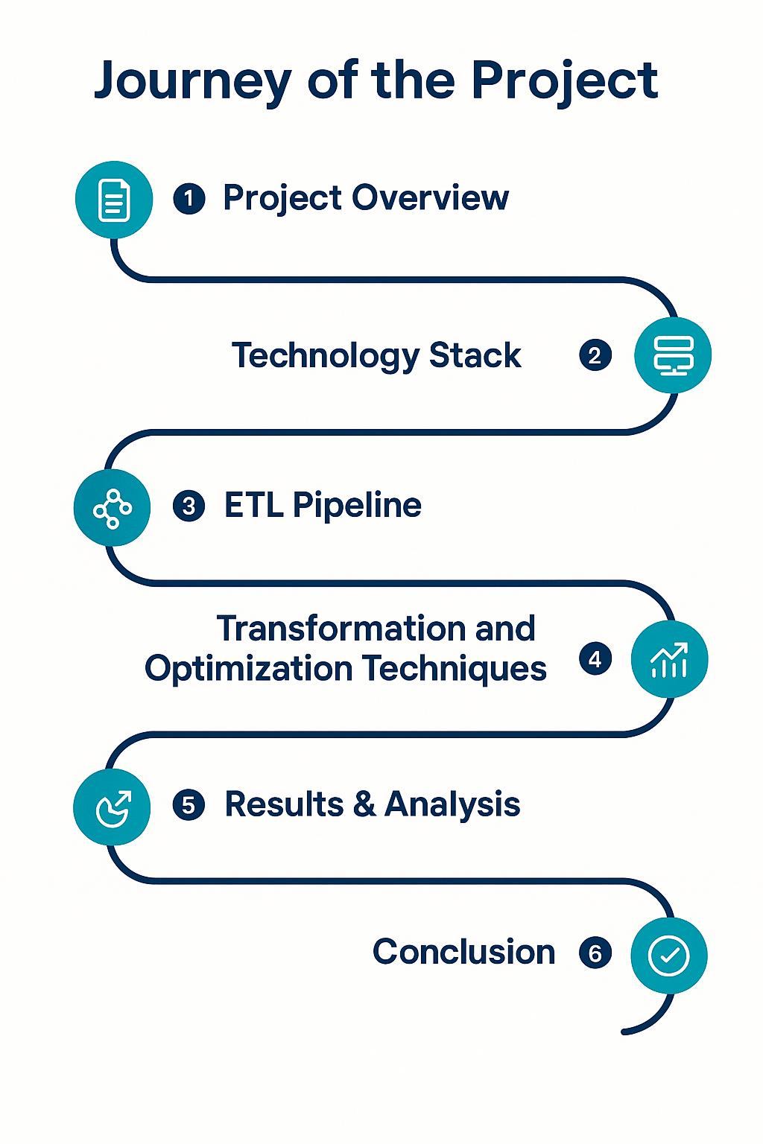

Name | Employee ID
Bellamkonda Venkata Sai Sriram Harsha | 30113672
Avula Sangeetha | 30113540
Perla venkata sai likhitha | 30113373
Vignesh Veeramani | 30113648
NirmalKumar C M | 30113623
Amarjith D | 30113577
Arunpandian B | 30113649

Slide 3
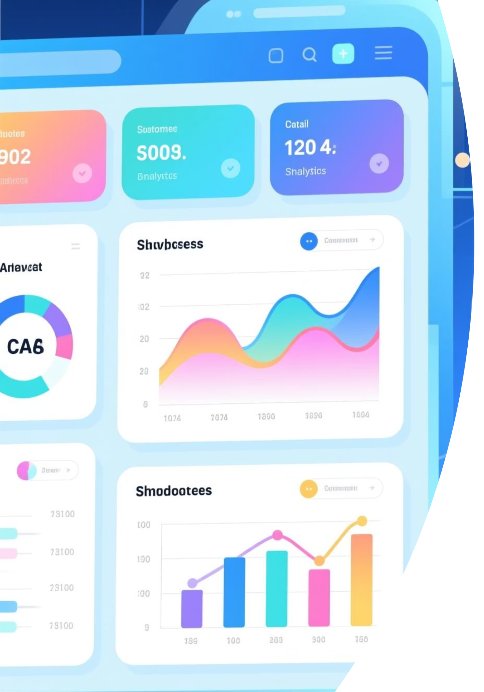
Project Overview
This ETL pipeline processes retail shopping data from multiple sources, cleans and transforms it for analytics, then stores results in PostgreSQL and Parquet formats.
Data Sources
Processing Engine
CSV and Excel files containing retail transactions
Apache Spark for scalable data transformation
Key Outputs
Spending patterns, top-rated items, age-based trends

Slide 4

Technology Stack
Core Technologies
Libraries & Tools
Programming: Scala
Spark SQL for querying
Framework: Apache Spark
Spark Excel for file handling
Database: PostgreSQL
Typesafe Config for configuration
File Formats: CSV, Excel, Parquet
Power BI

Slide 5






ETL Pipeline Architecture
Extract
Transform
Validate
Load
Analytics
The pipeline follows a systematic approach to ensure data quality and consistency at each stage.

Slide 6
Key Data Challenges
Missing Values
Duplicate Records
Column Normalisation
Handled using mean, median, or default values for data completeness
Removed to ensure data integrity and accurate analytics
Standardised naming conventions for consistency across datasets
Data Type Casting
Scale Management
Ensured numeric fields are properly typed for calculations
Optimised processing for large retail datasets

Slide 7
Transformations Optimisations
Applied Spark SQL functions to ensure data quality and business relevance:
Fill Missing Data
Schema Inference
Spark auto-detects column types (inferSchema = true)
Fill numeric nulls with mean/median; strings with “Unknown”;
generate IDs for missing Customer_ID.
Remove Duplicates
Columnar Storage
Store output in Parquet for faster queries and compression.
Drop full-row duplicates using dropDuplicates()
Rename Columns
Disable Broadcast Join
Avoid memory issues for large tables (autoBroadcastJoinThreshold = -1).
Replace spaces and special characters with _.
Type Casting
Shuffle Partitions
Set to 16 for balanced parallelism (spark.sql.shuffle.partitions).
Convert Purchase_Amount & Review_Rating to Double, Age to Int.
Business Filters
Separate Tables
Write analytical outputs into multiple PostgreSQL tables for modular queries.
Keep rows where Purchase_Amount > 100 and Review_Rating > 4

Slide 8

Results & Analytics Output
The pipeline generates cleaned datasets and actionable insights stored across multiple formats:
PostgreSQL Tables
Parquet Files
shopping_analysis, spend_per_location, top_items_by_review, avg_purchase_by_age_group
Optimised columnar format for fast querying and analytics
Key Insights
Spending patterns, location trends, product performance, demographic analysis

Slide 9
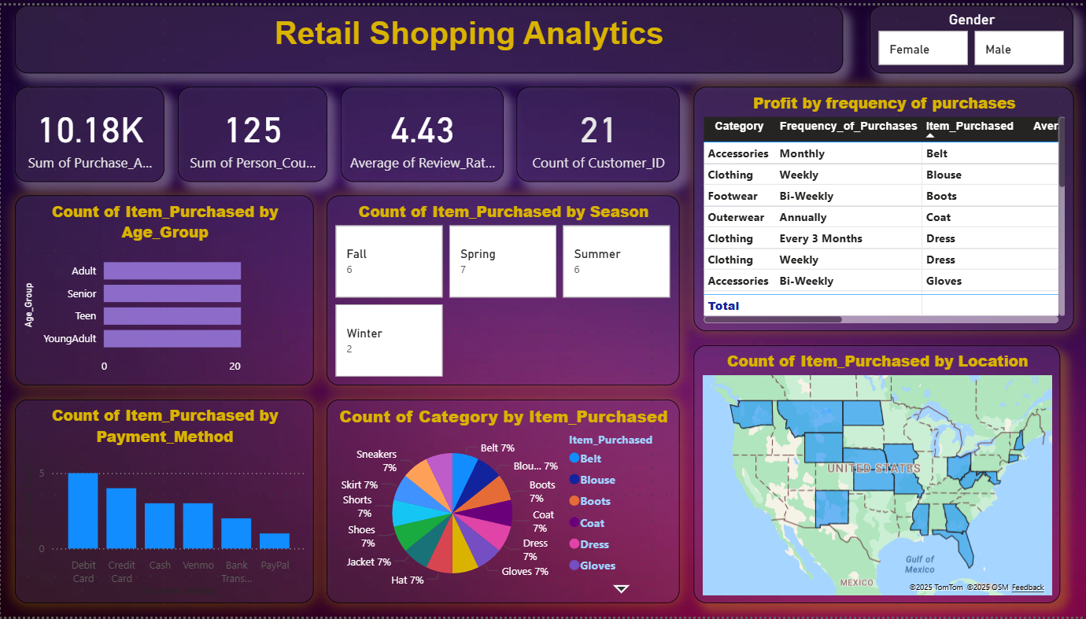

Slide 10
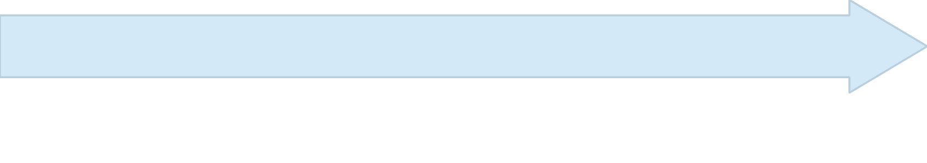

Future Development Roadmap
Machine Learning
Real-Time Streaming
Implement predictive models for forecasting
Add live data ingestion for immediate insights
Data Validation
Interactive Dashboards
Enforce rules for incoming file quality
Create BI tool visualisations for stakeholders

Slide 11


Conclusion
The ETL pipeline successfully processes retail shopping data, delivering cleaned, normalised datasets ready for analytics. Built on Apache Spark for scalability and efficiency, it provides meaningful business insights whilst remaining flexible for future enhancements including real-time analytics and predictive modelling.
Key Achievement: Scalable, production-ready ETL solution enabling data-driven retail decision-making.

Slide 12


